Slide 1
Why Mobile Security is not Like Traditional Security
Part 1: I convince you there is a problem
Part 2: I argue that solutions are possible
Markus Jakobsson, PayPal

Slide 2
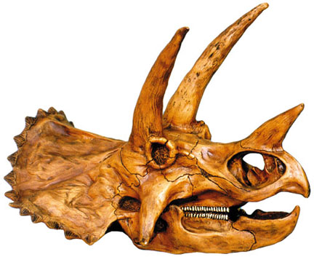
We do have a problem
Social (ab)use
Lack of crypto
Power limitations
Our own inertia
Limited user interfaces
Notes:
Lack of crypto: premium SMS for payments. Social (ab)use: social phishing stats. Power limitations: AV problems.
Limited user interfaces: Pwd nightmare. CAPTCHA nightmare.
Corporate attitudes: No problem until catastrophe. (Can only measure what already happens, problems are explosive.)
Our own inertia: we port to mobile

Slide 3
Imagine: 30 mins after leaving home…

Slide 4

Some UI problems
Your password must
have at least one digit
and at least one special
character, and …
Please enter the name
of your maternal
grandma’s best friend’s
first pet

Slide 5
Password Entry Pain
Difficulty
entering
passwords
Lack of coverage
Small
screen
size
Short battery life
1 2 3 4 5
Slow Web connection
Difficulty
customizing
settings
Poor voice quality

Slide 6
Password Entry Pain
(cumulative distribution)
x 2.5

Slide 7
Translation to reality-speak
“People hate passwords”
“Accept PINs; cache credentials;
add remember-me features. Worry about the consequences when they surface.”

Slide 8
Another reaction
“Mobile malware is here”
“Right now, use signatures for mobile, too. Worry about the consequences when they surface.”

Slide 9
How it should be
“Develop secure and less annoying authentication/anti-virus methods.”

Slide 10
So let’s look at what to do!
Part 1: Power

Slide 11
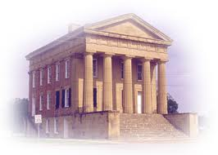

Let’s talk about power!
Software-based attestation: Verify no active malware before running sensitive routine
This way, only occasional verification
connection
request
Ok?
Ok!
Verify
Some more details at www.fatskunk.com + contact me

Slide 12
Let’s talk about power!
Software-based attestation: Verify no active malware before running sensitive routine
This way, only occasional verification
connection
request
connection
malware scan (flash)
vote cast
storage decryption
login process
Some more details at www.fatskunk.com + contact me

Slide 13




How?
monolith
kernel
Swap out all programs (malware may refuse)
cache
RAM

Slide 14
How?
monolith
kernel
Swap out all programs (malware may refuse)
Overwrite all “free” RAM pseudo-random content(malware refuses again)
cache

Slide 15

How?
monolith
kernel
Swap out all programs (malware may refuse)
Overwrite all “free” RAM
pseudo-random content(malware refuses again)
cache

Slide 16
How?
monolith
kernel
Swap out all programs
(malware may refuse)
2. Overwrite all “free” RAM
pseudo-random content
(malware refuses again)
3. Compute keyed digest of all RAM
(access order unknown a priori)
cache

Slide 17

How?
monolith
kernel
Swap out all programs
(malware may refuse)
2. Overwrite all “free” RAM
pseudo-random content
(malware refuses again)
3. Compute keyed digest of all RAM
(access order unknown a priori)
cache

Slide 18
How?
monolith
kernel
Swap out all programs
(malware may refuse)
2. Overwrite all “free” RAM
pseudo-random content
(malware refuses again)
3. Compute keyed digest of all RAM
(access order unknown a priori)
cache
External verifier provides this
RAM

Slide 19
How?
monolith
kernel
Swap out all programs
(malware may refuse)
2. Overwrite all “free” RAM
pseudo-random content
(malware refuses again)
3. Compute keyed digest of all RAM
(access order unknown a priori)
cache
External verifier will time this
(and check result of computation)
RAM

Slide 20
Part 2: UIs

Slide 21
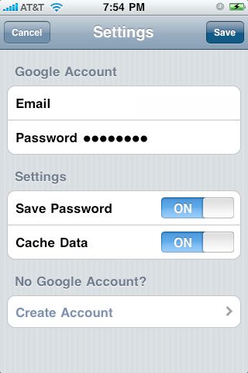
Smaller Keyboard: Slower = Less Secure

Slide 22
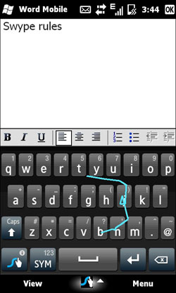
Why Not Use Error Correction?

Slide 23

A “Fastword”: Several Dictionary Words
(Three, For Example)
Enter fastword:
Paper & very crude demo at www.fastword.me

Slide 24
Fastwords: How Secure?
Password average
(18 bits)
2 out of 3
Fastword
3 out of 3
Fastword
(cumulative distribution)

Slide 25
Fastwords: How Fast?
(cumulative distribution)

Slide 26
Part 3: our inertia

Slide 27
Some issues we all know about
(but choose to ignore)
Pushing back on weak credentials
Dealing with special cases (such as resets)
Discouraging credential reuse
Getting to the bottom with 419, phishing, etc.
Privacy issues – sometimes at odds with security
(Of course, these are not pure mobile problems, but I
believe that they will be aggravated as the world
turns mobile.)

Slide 28
The problem of weak credentials
Q. What is the greatest problem?
A. Identifying when it happens.
Relevant paper at www.fastword.me

Slide 29
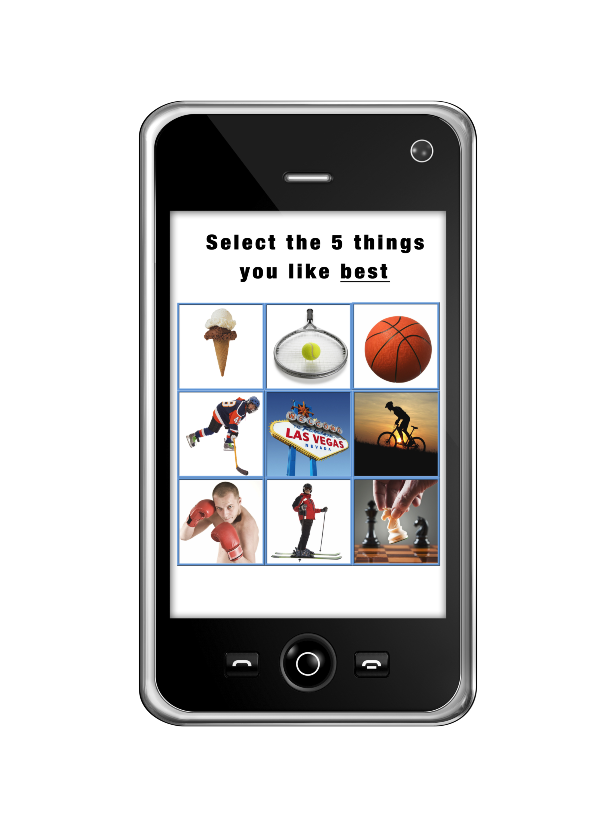
Resets
Easy to guess or data mine, yet hard to remember?
  What was the brand/color of your first car?
  What is your mother’s maiden name?
  What address did you grow up at?
  What is the brand of your refrigerator?
  What is your favorite restaurant?
Hard to use on a handset?
And a big one:
Slow registration!

Slide 30
Avoiding credential reuse
Q. Why do people reuse passwords?
A. Because they can!
Relevant paper at visual-blue-moon-authentication.com

Slide 31
Limiting phishing
A phishing attack is successful when:
Phisher spoofs trusted site, and
User reaction to (1) results in leak of credential.

Slide 32
Privacy intrusion or not?
Keyboard biometrics?
Calling behavior? Location?
Face recognition?

Slide 33
Disclaimer
These are my opinions. Not PayPal’s.
I own some of these things. I am not impartial.
Some of this is published. Other stuff is not. Contact me for more information.
More information at
www.markus-jakobsson.com
www.mobile-blue-moon-authentication.com
www.fatskunk.com
www.fastword.me

